Slide 1

Ghani Khan Choudhury Institute of Engineering and Technology
Unsupervised Learning for Cryptocurrency Market Analysis
Presented by – Soumen Mondal
Roll no. – 35530824078
Reg. no. – 243550120261
Department – CSE (AI & ML)
Year – 3rd , Sem. – 2nd
Academic Year :– 2025-26

Slide 2
Problem Statement
Cryptocurrency markets generate large amounts of price data every day . However, this data has no labels such as “good” or “ bad ” . Therefore, supervised learning cannot be used . So, we apply unsupervised learning to find hidden patterns.
Goals
To identify market trends
To detect abnormal price movements
To reduce data complexity
To support investment decisions

Slide 3
Dataset Description (with Dummy Data)
We used the dataset Solana_Price_dataset created means dummy dataset . It contains daily trading information such as : Opening Price , High price , Low price , Close price , and Treading Volume . All values are numerical and no labels are present.
Dataset Characteristics:
Number of samples: Total trading days in dataset
Number of features: 5 (Open, High, Low, Close, Volume)
Data type: Continuous numerical values
Labels: Not available
Data source: Cryptocurrency market data
Learning type: Unsupervised Learning

Slide 4
Preprocessing
Raw data contains different scales and noise .
So preprocessing is required to improve performance.
Why Preprocessing is Required?
Removes noise and unwanted data
Handles missing values
Brings all features to same scale
Improves accuracy of clustering
Reduces effect of outliers
Makes data suitable for machine learning
Preprocessing Steps used
Scaling (StandardScaler)
Normalization (MinMaxScaler)
Feature selection
Removing unnecessary columns

Slide 5
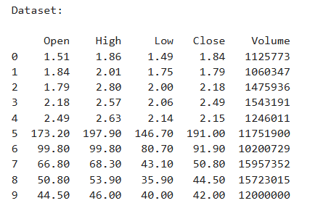
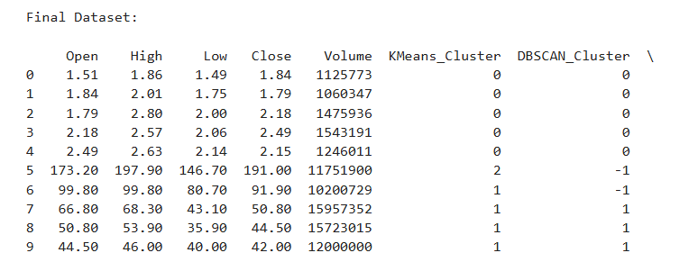
Dummy Dataset

Slide 6
Algorithms Used
K-Means
Groups data into clusters
Finds market phases
DBSCAN
Detects abnormal points
Finds crashes and spikes
RBM
Neural network
Learns hidden features

Slide 7
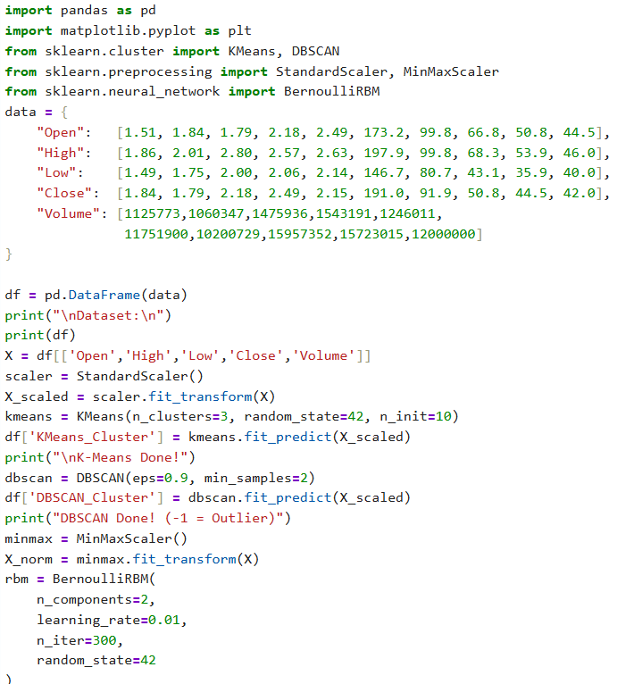
Python Implementation

Slide 8
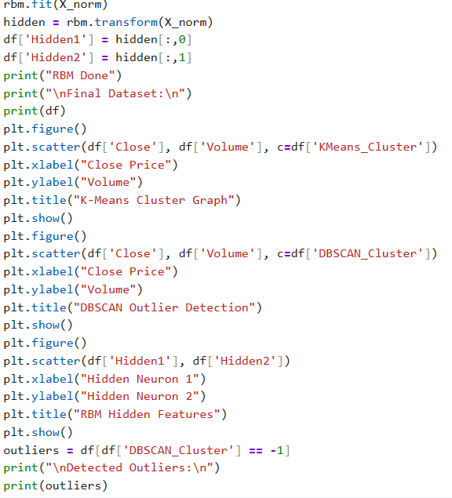

Slide 9
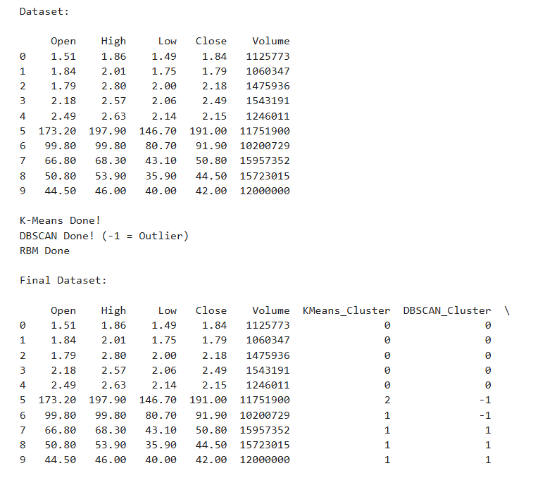
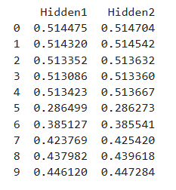
Results

Slide 10
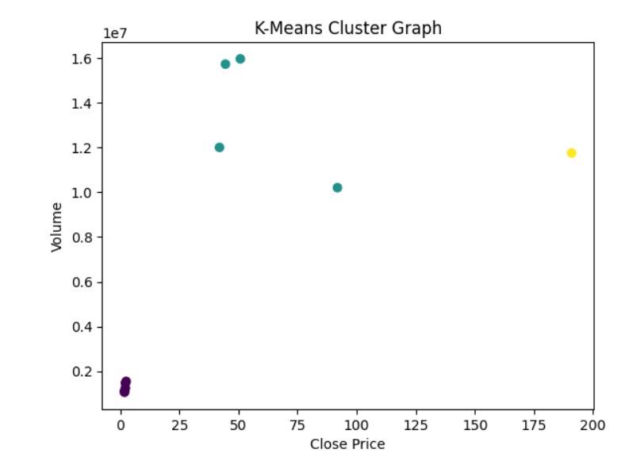
K-Means Clustering
This graph shows clustering of Solana prices .
Same color represents same market behavior.
Three clusters indicate different market phases.
Result
Stable
Bullish
Bearish

Slide 11
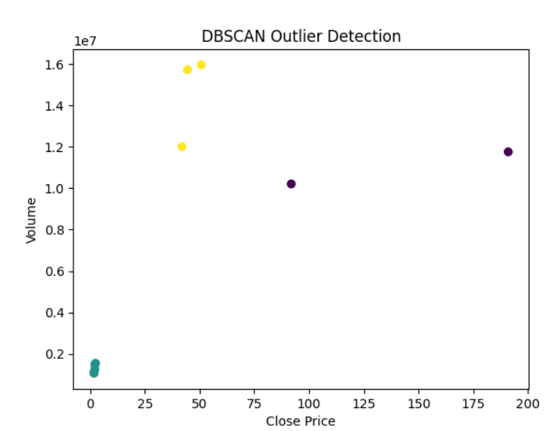
DBSCAN(Density-Based Spatial Clustering of Applications with Noise) Outliers
This graph shows abnormal trading days.
Points marked as -1 are outliers .
These represent crashes or spikes.
Result
Risk Detection

Slide 12
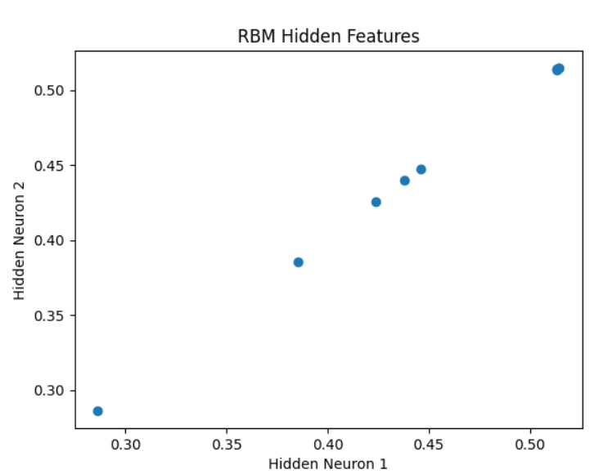
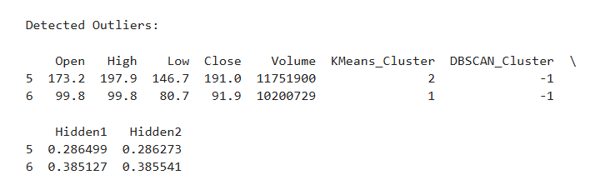
RBM(Restricted Boltzmann Machine) Hidden Layer
This graph shows hidden features learned by RBM.
It converts original data into new representation .
Similar points indicate similar market behavior.
Result
Feature learning

